Slide 1
The case for an against food addiction:
A scientific and legal analysis
Robert H. Lustig, M.D., M.S.L.
Division of Endocrinology, Dept. of Pediatrics
Institute for Health Policy Studies
University of California, San Francisco
I’m Sweet Enough, Toronto, Ont. Canada, Sept. 16, 2018

Slide 2

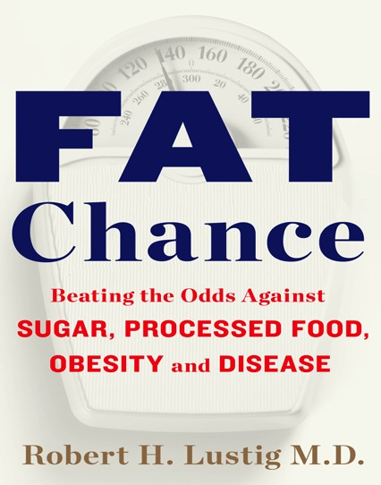
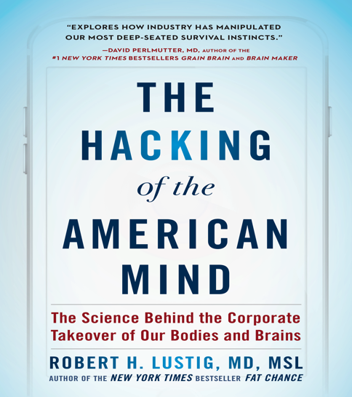
Disclosures
BIOLUMEN
Technologies

Slide 3
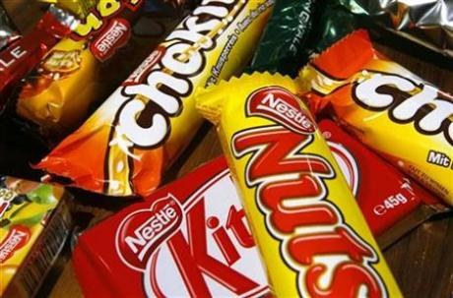
Junk food addiction may be clue to obesity: study
(Reuters) March 28, 2010 - Bingeing on high-calorie foods
may be as addictive as cocaine or nicotine, and could cause
compulsive eating and obesity, according to a study
published on Sunday.
Johnson and Kenny, Nat Neurosci 2010

Slide 4
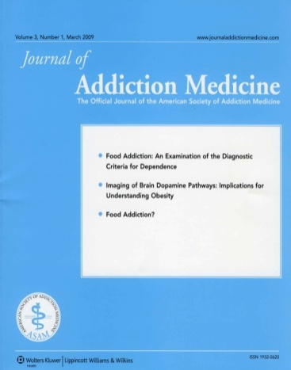
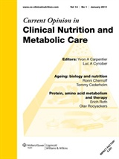
The evolution of “food addiction”
2009
2010
EDITOR: Mark S. Gold
SPECIAL ISSUE: FOOD ADDICTION
Daniel M. Blumenthal and Mark S. Gold
NEUROBIOLOGY OF FOOD ADDICTION

Slide 5
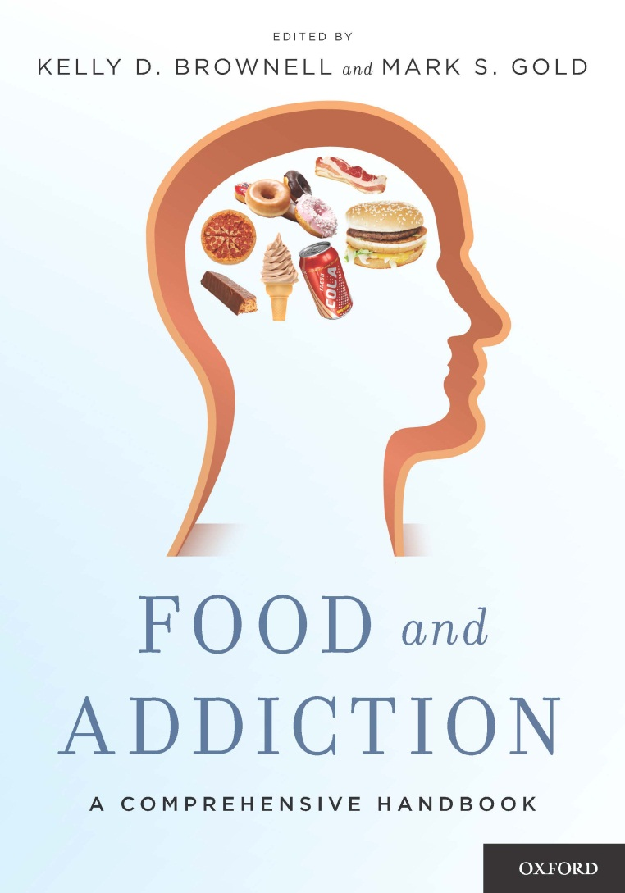
2012

Slide 6
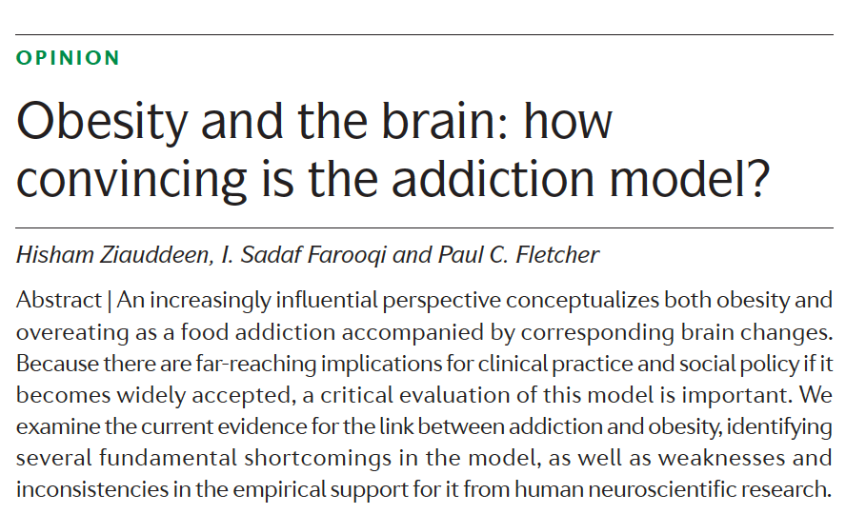
Nature Rev Neurosci 13:279, 2012

Slide 7
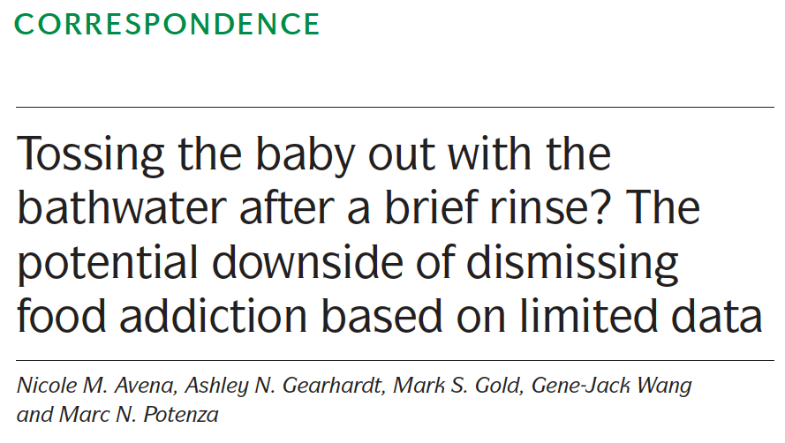
Nature Rev Neurosci 13:514, 2012

Slide 8
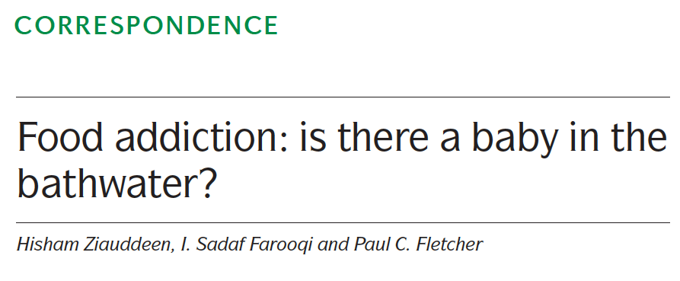
Nature Rev Neurosci 13:514, 2012

Slide 9
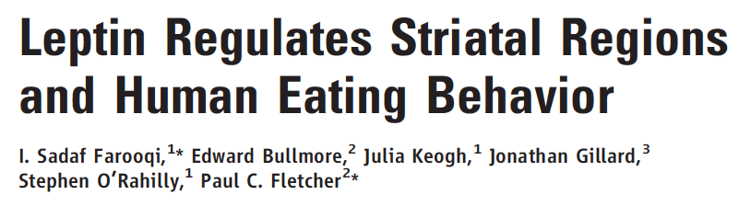
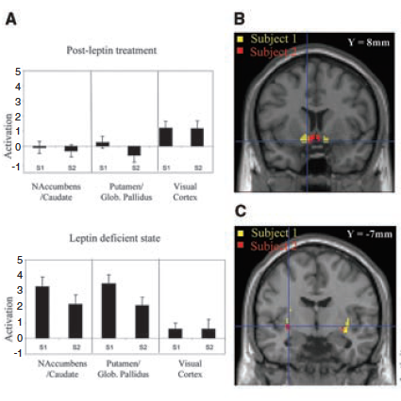
Science 317:1355, 2007

Slide 10
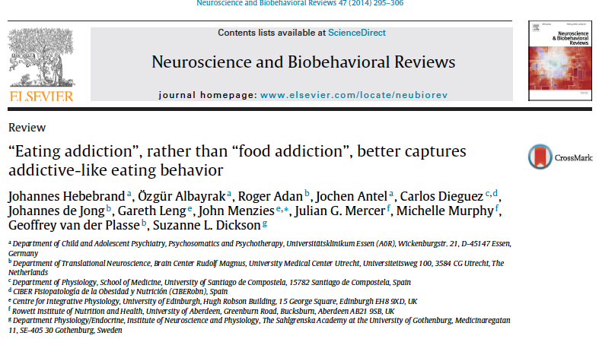
Puts the onus on the individual, not the food

Slide 11
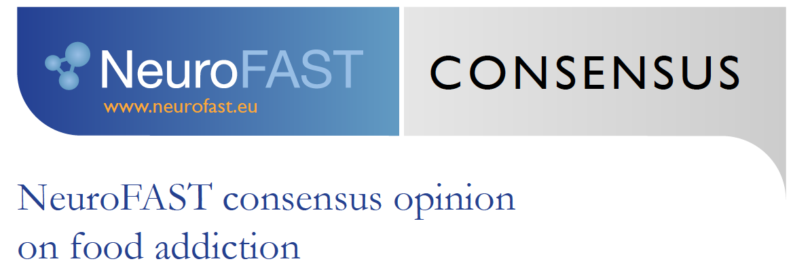
• Current evidence does not allow us to conclude that a single food substance via a single specific neurobiological mechanism (e.g. specific brain receptors or specific neuronal pathways) can account for the fact that people overeat and develop obesity.
•In humans, there is no evidence that a specific food, food ingredient or food additive causes a substance-based type of addiction (the only currently known exception is caffeine which via specific mechanisms can potentially be addictive).

Slide 12
• Within this context we specifically point out that we do not consider alcoholic beverages as food, despite the fact that one gram of ethanol has an energy density of 7 kcal.
• Addictive (over)eating is clearly distinct from substance use disorders that cause addiction via specific mechanisms (e.g. nicotine, cocaine, cannabinoids, opioids, etc).
So, NeuroFAST exempts both alcohol and caffeine, even though both are in food

Slide 13
If:
— it’s about obesity; or
— it’s about eating addiction; or
— no specific foodstuff is addictive,
then the food industry has “carte blanche”;
and there is no option for societal intervention

Slide 14
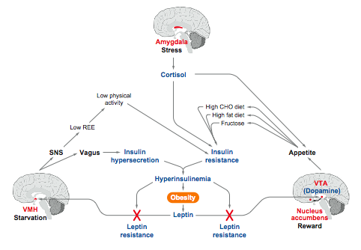
The “limbic triangle”
Mietus-Snyder and Lustig, Ann Rev Med 59:147, 2008

Slide 15
Could one specific ingredient in food cause addiction?
Need to look for similarities to drugs of dependence
• nicotine
• morphine
• amphetamine
• cocaine
• ethanol

Slide 16
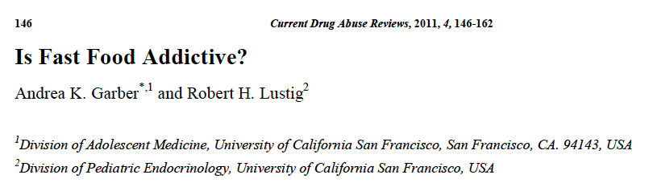

Slide 17
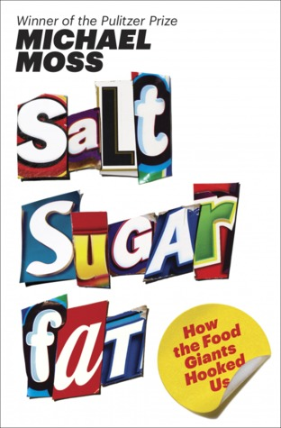

Slide 18
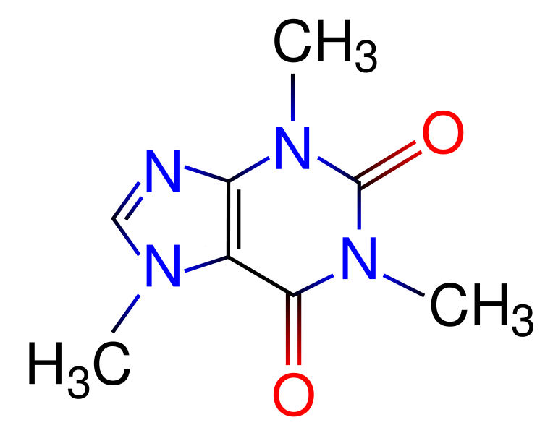
Caffeine

Slide 19
Salt
In rodents, dopamine signaling (reward) in response to salt, bingeing, cross-sensitization with amphetamines
In humans,
  Lower threshold physiologically fixed
  Higher levels attributed to “preference”, can retrain
  Salt-losing congenital adrenal hyperplasia
Notes:
Salt preference in 4-6 mo old infants according to salt content of formula and water used to prepare it

Slide 20
Caffeine

Slide 21
Caffeine

Slide 22
Fat
Rodents binge but no signs of dependence
In humans, binge foods are high fat but also high carb/sugar (e.g. pizza, ice cream)
  Likely synergy, adding sugar increases preference for fatty foods [Drewnowski et al.]
Atkins diet does not show dependence
Energy density: stronger association with obesity, metabolic syndrome

Slide 23
Caffeine

Slide 24
Caffeine

Slide 25
Caffeine
“Model drug” of dependence
In humans, dependence shown in children, adolescents and adults
  30% who consume it meet DSM criteria for dependence
  Physiologic addiction established: headache (increased cerebral blood flow). Impaired task performance, fatigue

Slide 26
Caffeine

Slide 27
Caffeine

Slide 28
Direct effects on the reward system:
Is sugar (fructose) addictive?
Garber and Lustig, Curr Drug Abuse Rev 4:190, 2011

Slide 29
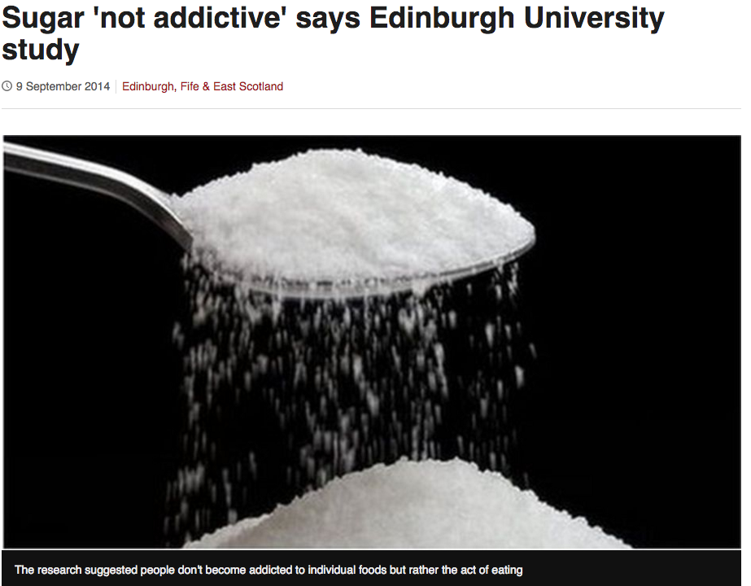
Hebebrand et al. 2014
Neurofast (a review, not a study)

Slide 30


Slide 31
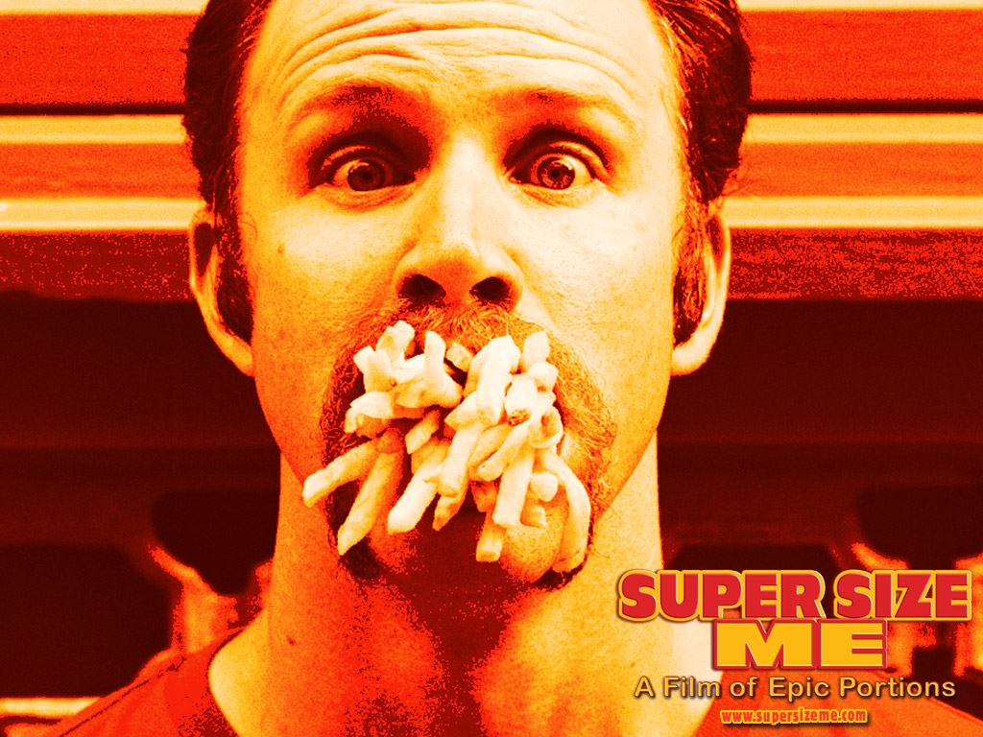

Slide 32


Slide 33
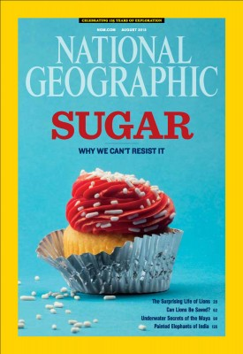

Slide 34
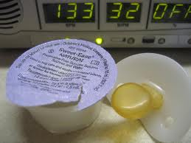
Sugar and opioids
Sweet-Ease increases endogenous opioids to reduce pain,
Even in neonates

Slide 35
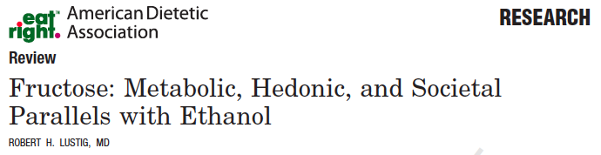
Lustig, J Am Diet Assoc 2010

Slide 36
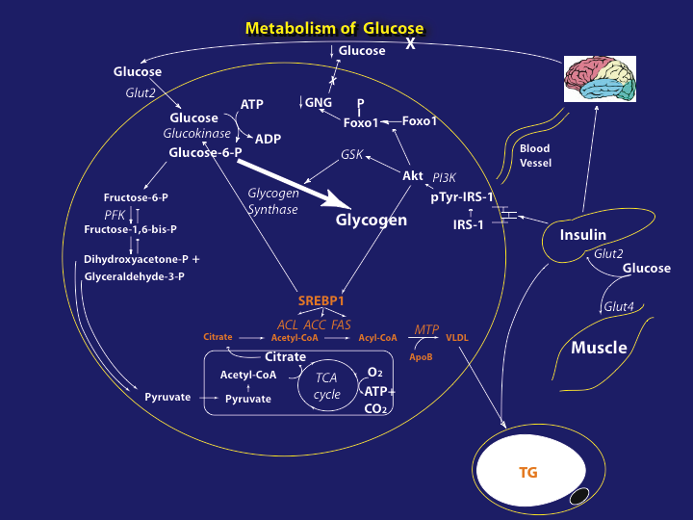
(20%)
(80%)

Slide 37
(80%)

Slide 38
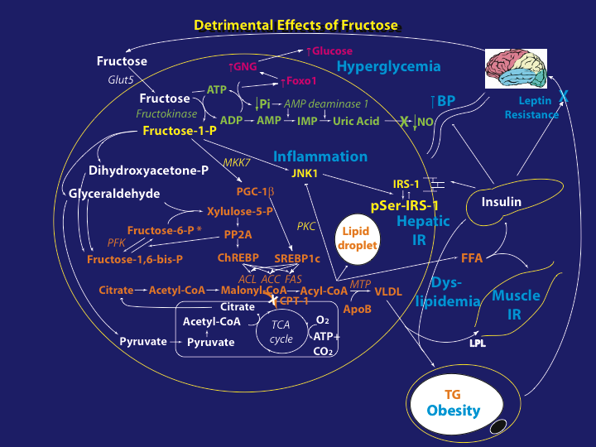
(100%)

Slide 39
What makes a milkshake so rewarding?
Normal weight young adult subjects, fMRI
Milkshakes with graded doses of fat vs. sugar
The fat stimulated the somatosensory cortex (e.g. mouthfeel)
Only sugar stimulated the nucleus accumbens
Adding more fat was not additive to the effect of sugar on reward
Stice et al. Am J Clin Nutr 98:1377, 2013

Slide 40
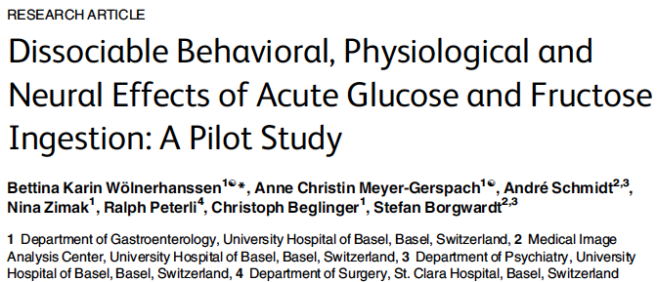
No satiety or fullness with fructose compared with glucose
No insulin rise with fructose compared with glucose
fMRI:
Glucose: caudate, putamen, precuneus, lingual gyrus
Fructose: amygdala, hippocampus, parahippocampus, orbitofrontal cortex
precentral gyrus
PLoS One 10(6):e0130280, 2014

Slide 41
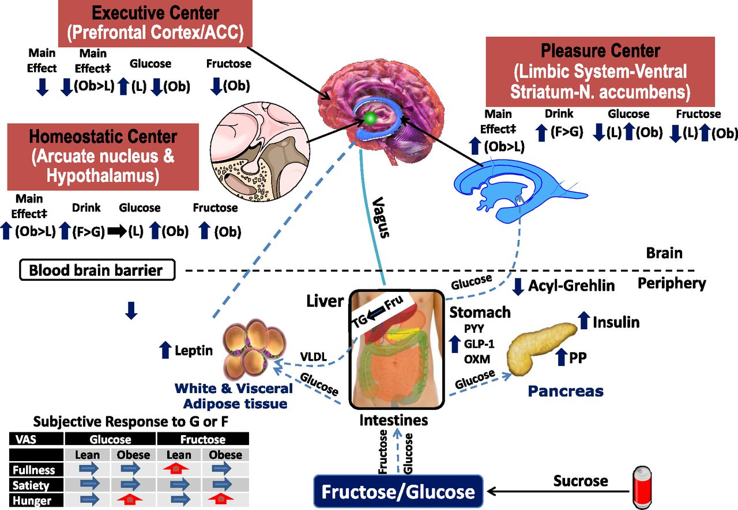
Effects of fructose and glucose on the brain in
normal and obese adolescents
Jastreboff et al. Diabetes 65:1929, 2016

Slide 42
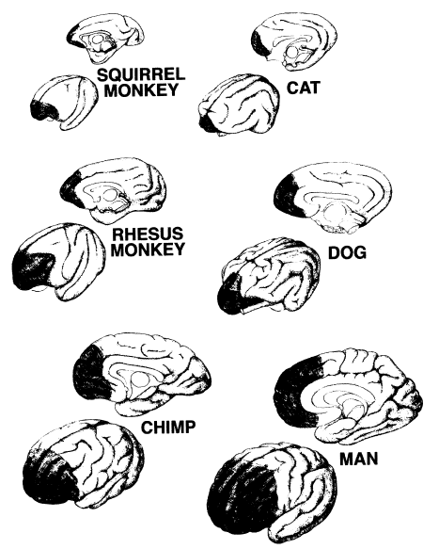
The prefrontal cortex (PFC)
The “executive function center”
The “Jiminy Cricket” of your brain
Fuster, J Neurocytol 31:373, 2002

Slide 43
Functions of the adult PFC
Arain et al. Neuropsych Dis Treat 9:449, 2013

Slide 44
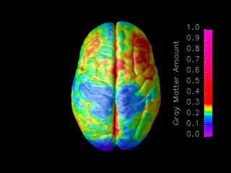
Ontogeny recapitulates phylogeny:
The PFC is the last area to develop, and the last to myelinate
Gogtay et al, Proc Natl Acad Sci 101:8174, 2004

Slide 45


Slide 46
1. Not all drugs “fry neurons”:
Benzodiazepines don’t (GABA – inhibitory)
Psychedelics don’t (Serotonin – inhibitory)
2. Only excitatory drugs lead to cell death
e.g. cocaine, ecstasy, meth, PCP
3. Unmyelinated neurons are more likely to die from chronic excitation, e.g. adolescent PFC’s

Slide 47
1. Not all drugs “fry neurons”:
Benzodiazepines don’t (GABA – inhibitory)
Psychedelics don’t (Serotonin – inhibitory)
2. Only excitatory drugs lead to cell death
e.g. cocaine, ecstasy, meth, PCP
3. Unmyelinated neurons are more likely to die from chronic excitation, e.g. adolescent PFC’s

Slide 48
1. Not all drugs “fry neurons”:
Benzodiazepines don’t (GABA – inhibitory)
Psychedelics don’t (Serotonin – inhibitory)
2. Only excitatory drugs lead to cell death
e.g. cocaine, ecstasy, meth, PCP
3. Unmyelinated neurons are more likely to die from chronic excitation, e.g. adolescent PFC’s

Slide 49
Drug abuse inhibits organization and functioning
of the PFC in adolescents
Arain et al. Neuropsych Dis Treat 9:449, 2013

Slide 50
Excitatory neurotransmitters, down-regulation, and addiction
Dopamine is excitatory
Long-term chronic firing can kill neurons
To protect themselves, neurons down-regulate the dopamine receptor
Get a hit, get a rush — receptors go down
Next time you need a bigger hit to get the same rush (tolerance)
When the neurons start to die, that’s addiction

Slide 51
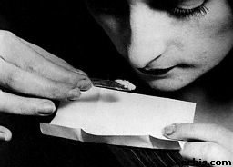
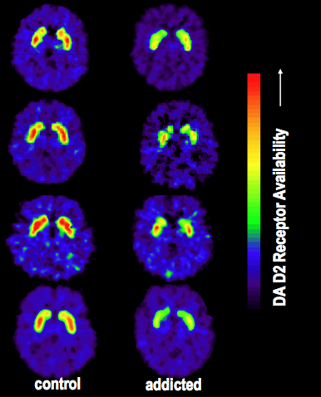
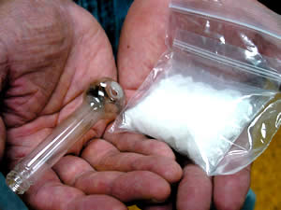
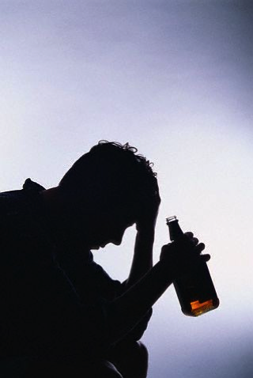
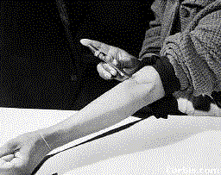
Dopamine receptors are lower in addiction
DA
Cocaine
DA
DA
DA
DA
DA
DA
DA
DA
DA
DA
DA
Meth
Reward Circuits
Non-Drug Abuser
DA
DA
Alcohol
DA
DA
DA
DA
Reward Circuits
Heroin
Drug Abuser
Volkow et al., 2002

Slide 52
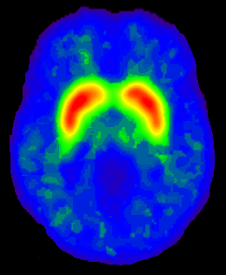
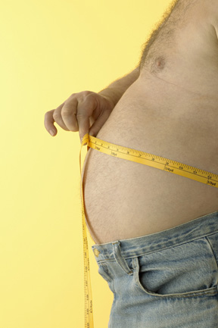
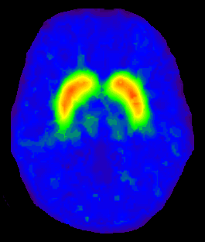
Lower dopamine receptors in obesity as well
[11C]raclopride
P < 0.002
Obese subjects (n = 10)
2
Control subjects (n = 10)
BMI
P < 0.3
0
10 Control Subjects
(BMI: 25±3 kg/m2)
ml/gm
Dopamine Receptor Concentration
10 Obese Subjects
(BMI: 51±5 kg/m2)
Wang et al, Lancet 2001

Slide 53
Stice et al. Am J Clin Nutr 98:1377, 2013, Wolnerhanssen et al, PLoS One 10(6):e0130280, 2014

Slide 54
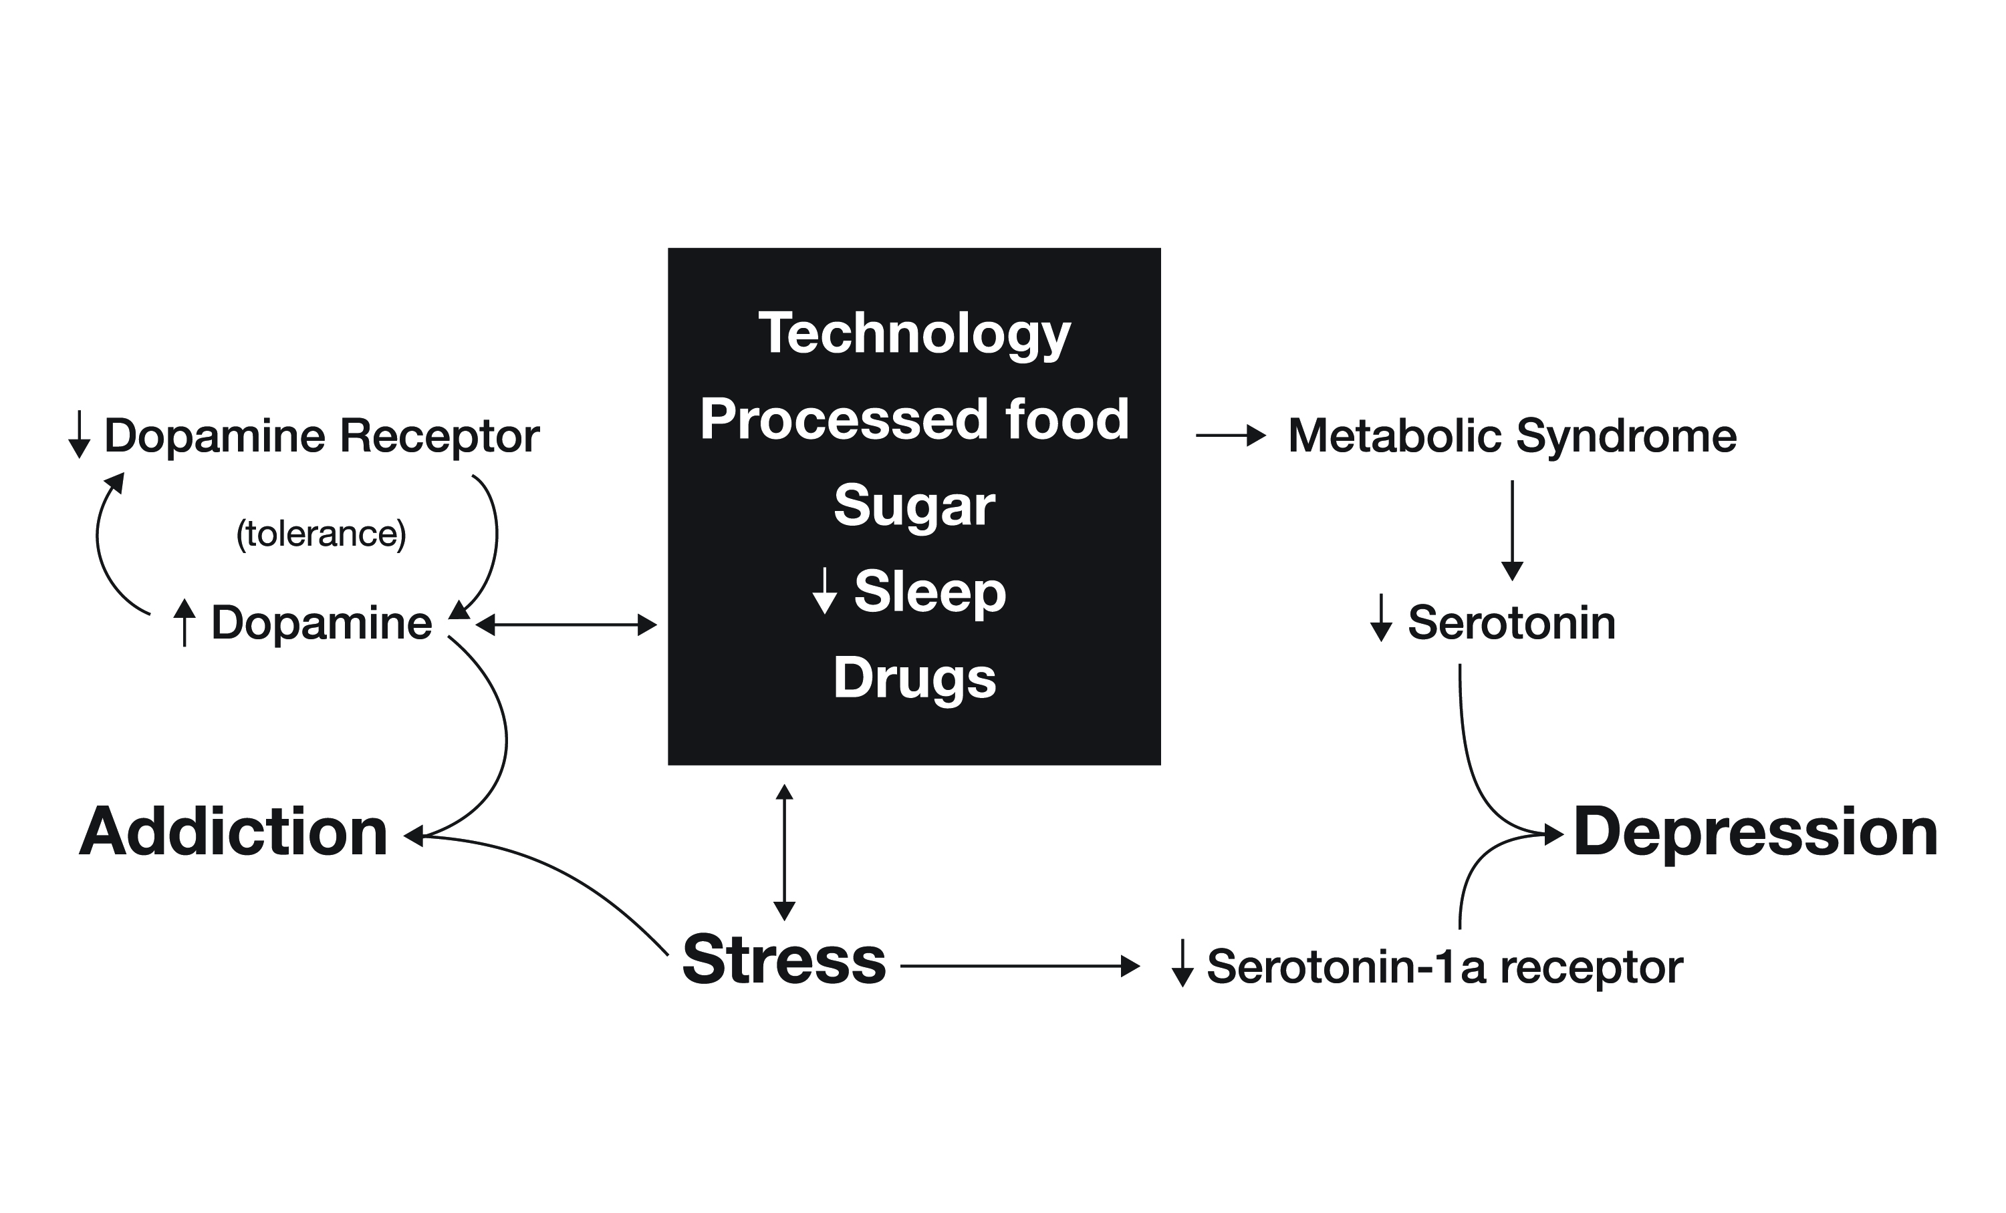
The dopamine-cortisol-serotonin interaction
PFC
Lustig, Avery Press, 2017

Slide 55
Tolerance and Withdrawal—
The DSM-IV criteria for addiction (1993)
2 criteria within a 12-month period:
Tolerance (CNS effects)
Withdrawal (systemic effects)
Physiologic

Slide 56
Tolerance and Withdrawal—
The DSM-IV criteria for addiction (1993)
2 criteria within a 12-month period:
Tolerance (CNS effects)
Withdrawal (systemic effects)
Physiologic
Withdrawal is due to systemic effects of substances on physiology
• caffeine- rCBF increase, EEG theta rhythm
• alcohol- seizures, DT’s (upregulation of glutamate receptors)
• nicotine- upregulation of glutamate receptors, downreg of GABA receptors
• cocaine- hyperthermia, hypoactivity, psychomotor retardation
• heroin- lacrimation, abdominal and leg cramping,
piloerection, nausea, vomiting, diarrhea, mydriasis, myalgia, arthalgia

Slide 57
Tolerance and Dependence—
The DSM-V criteria for addiction (2013)
2 of the 11 following criteria within a 12-month period:
Tolerance
Withdrawal
Craving or a strong desire to use
Use resulting in a failure to fulfill major role obligations (work, school, home);
Recurrent use in physically hazardous situations (e.g. driving);
Use despite social or interpersonal problems caused or exacerbated by use;
Taking the substance in larger amounts or over a longer period than intended;
Attempt to quit or cut down;
Time spent seeking or recovering from use;
Interference with life activities;
Use despite negative consequences.
Physiologic
Psychologic
(Dependence)

Slide 58
So is sugar addictive?
• Causative in animals
• Correlative in humans
— naïve populations?
— control group?
— caffeine overlay?

Slide 59
So is sugar addictive?
• Causative in animals
• Correlative in humans
Don’t say addictive, say “abused”
— Laura Schmidt, Ph.D.,
Institute of Health Policy Studies, UCSF

Slide 60
•In humans, there is no evidence that a specific food, food ingredient or food additive causes a substance-based type of addiction (the only currently known exception is caffeine which via specific mechanisms can potentially be addictive).
• Within this context we specifically point out that we do not consider alcoholic beverages as food, despite the fact that one gram of ethanol has an energy density of 7 kcal.
Alcohol and caffeine are really “food additives”

Slide 61
Is sugar a “food”?
FDCA: 321.201(f) The term "food" means (1) articles used for food or drink for man or other animals, (2) chewing gum, and (3) articles used for components of any such article.

Slide 62
Is sugar a “food”?
FDCA: 321.201(f) The term "food" means (1) articles used for food or drink for man or other animals, (2) chewing gum, and (3) articles used for components of any such article.
Webster: a material consisting essentially of protein, carbohydrate, and fat used in the body of an organism to sustain growth, repair, and vital processes and to furnish energy; also: such food together with supplementary substances (as minerals, vitamins, and condiments)

Slide 63
Is sugar a “food”?
FDCA: 321.201(f) The term "food" means (1) articles used for food or drink for man or other animals, (2) chewing gum, and (3) articles used for components of any such article.
Webster: a material consisting essentially of protein, carbohydrate, and fat used in the body of an organism to sustain growth, repair, and vital processes and to furnish energy; also: such food together with supplementary substances (as minerals, vitamins, and condiments)
Sugar provides only energy, but that should make it a food, right?

Slide 64
Can you name an energy source that is:

Slide 65
Can you name an energy source that is:
Not necessary for life

Slide 66
Can you name an energy source that is:
Not necessary for life
There is no biochemical reaction in the body that requires it

Slide 67
Can you name an energy source that is:
Not necessary for life
There is no biochemical reaction in the body that requires it
Is not nutrition

Slide 68
Can you name an energy source that is:
Not necessary for life
There is no biochemical reaction in the body that requires it
Is not nutrition
When consumed in excess it is toxic

Slide 69
Can you name an energy source that is:
Not necessary for life
There is no biochemical reaction in the body that requires it
Is not nutrition
When consumed in excess it is toxic
We love it anyway, and it’s addictive

Slide 70
Can you name an energy source that is:
Not necessary for life
There is no biochemical reaction in the body that requires it
Is not nutrition
When consumed in excess it is toxic
We love it anyway, and it’s addictive
Answer: Ethanol

Slide 71
Aside from sugar, are there other energy sources that aren’t foods?
Alcohol
Trans-fats
These are NOT foods;
Trans-fats was recently reclassified by the FDA (2013)
Neither one is currently considered Generally Recognized as Safe (GRAS)

Slide 72
The FDA has reclassified Trans-Fats and Nitrates as
NOT GRAS
Could we reclassify sugar as NOT GRAS?

Slide 73
Could we get sugar reclassified as a “food additive”?
Being addictive doesn’t get you off the GRAS list: e.g. caffeine
GRAS is defined (FDCA, 321(s)) as “generally recognized, among experts qualified by scientific training and experience to evaluate its safety, as having been adequately shown through scientific procedures (or, in the case of a substance used in food prior to January 1, 1958, through either scientific procedures or experience based on common use in food) to be safe under the conditions of its intended use.”
So GRAS is about “toxicity”, not addiction.
The current level of consumption (90-100 lb/yr) was never intended.

Slide 74
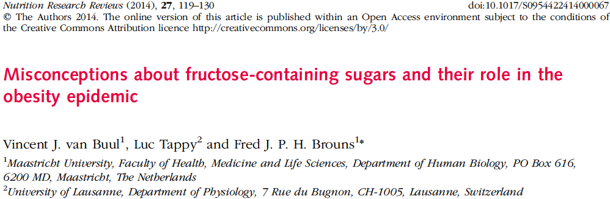
Criticism from the nutritional community
“To say that fructose is toxic is a total misconception of the
nature of the molecule….If you have too much oxygen, it is toxic.
If you get too much water, you have water intoxication.
That doesn’t mean we say oxygen is toxic”.
– Fred Brouns, Atlantic Monthly, USA, June 5, 2014

Slide 75
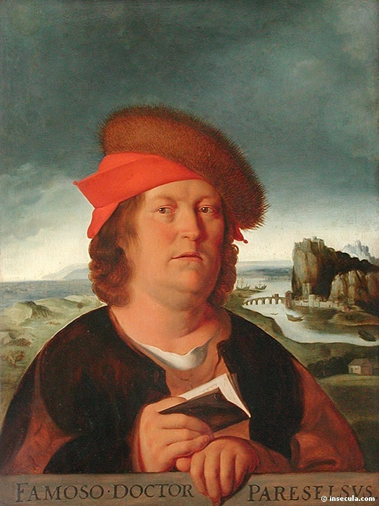
Poison is in everything and no thing is without poison.
The dosage makes it either a poison or a remedy.
    Paracelsus
    1493-1541
Notes:
Why a presentation about GRAS? Because GRAS as applied is a flawed concept. It fails to take into account the fact that the dosage makes the poison. Everything is poisonous beyond a certain level.

Slide 76
Items on the GRAS list that are poisonous in high dose
  Iron
  Vitamin D
  Phosphate salts
  Water
  Oxygen
  But none of these have abuse potential

Slide 77
GRAS or Food Additive
A GRAS substance is distinguished from a food additive on the basis of the common knowledge about the safety of the substance for its intended use rather than on the basis of what the substance is or the types of data and information that are necessary to establish its safety.

Slide 78
Sugar known to India 1200 BCE
Sugar on FDA’s GRAS list since its inception in 1958
Last evaluation by FDA 1986 (before HFCS glut)
Avg. consumption:
51 gm/day sugar
25.5 gm fructose
(HALF AS MUCH AS WE CONSUME TODAY)
Result: Inconclusive
Glinsmann et al. J. Nutr 116:1/S, 1986

Slide 79
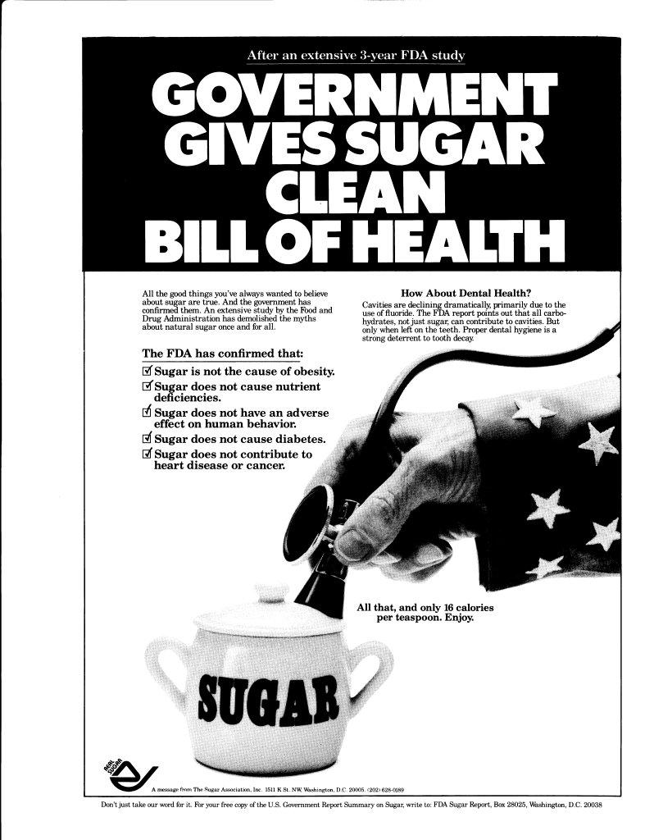
Response of the sugar industry
Notes:
So, everything that the international evidence show works involves gently controlling the availability of alcohol. There are a variety of ways this is done, and all seem to work pretty well.
Outright prohibition has all sort of bad side effects. But gentler controls on availability work without so many bad side effects.
Analogies for suger: tightening zoning requirements on fast food franchises. At the same time, using local zoning laws to promote grocery stores and farmer’s markets. Another would be to license vending machines in schools and workplaces. If sugar is less available, people will simply eat it less—the iron law.
.

Slide 80
Two Ways to Get to GRAS
21 CFR 170.30(c) and 170.3(f), general recognition of safety through experience based on common use in foods requires a substantial history of consumption for food use by a significant number of consumers
  (this is what has been done by the food industry).
21 CFR 170.30(b), general recognition of safety through scientific procedures requires the same quantity and quality of scientific evidence as is required to obtain approval of the substance as a food additive and ordinarily is based upon published studies, which may be corroborated by unpublished studies and other data and information
  (this is what our data have shown).
Notes:
1997 Regulations- doesn’t actually have to be peer reviewed.

Slide 81
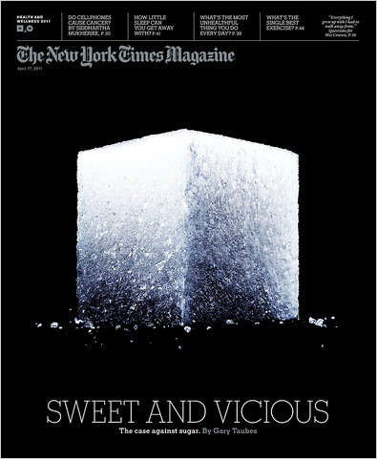
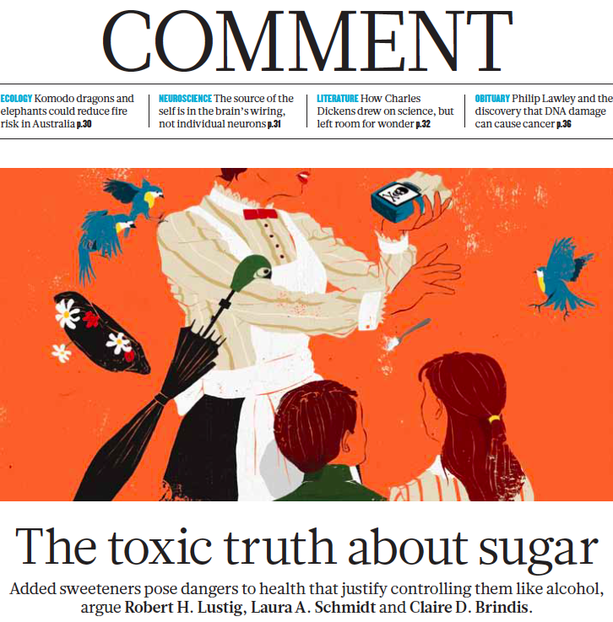
Nature 487:27-29, Feb 1, 2012
New York Times, April 17, 2011

Slide 82
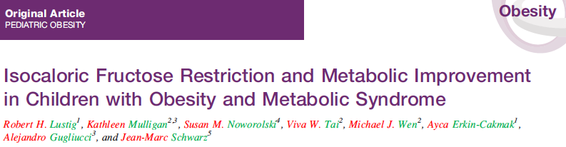
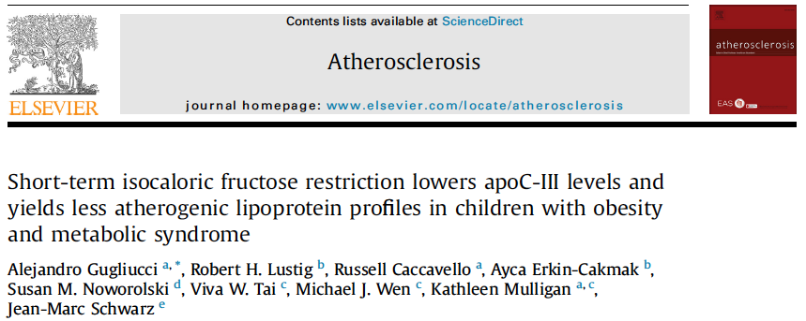
Sugar is toxic unrelated to calories or weight

Slide 83
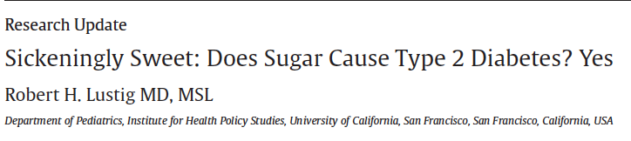
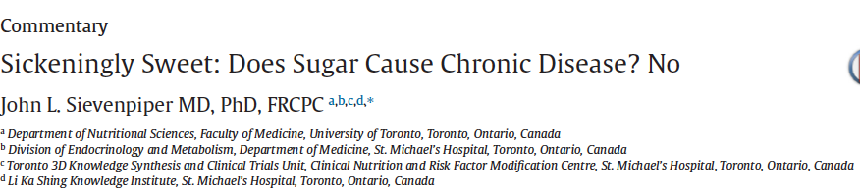
Debate amongst scientists about sugar toxicity
Can J Diab 40:282, 289, 2016

Slide 84


Slide 85
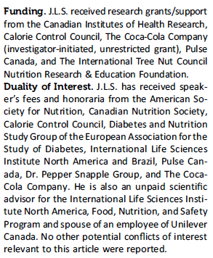
But those who debate against toxicity take money from the food industry

Slide 86
But those who debate against toxicity take money from the food industry
Vincent Van Buul Product Development Coordinator, Gruma/Mission Foods
Luc Tappy Recipient of Numerous Fructose Grants, Nestle
Fred Brouns Cargill Manager of Nutritional Sciences until 2008,
now runs nutrition and health consulting firm

Slide 87
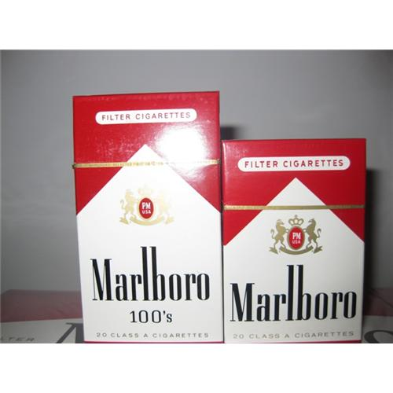
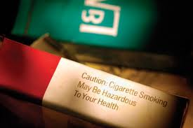
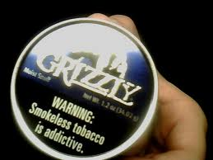
Addictive and hazardous to your health

Slide 88

Addictive and hazardous to your health

Slide 89
Summary — how does the science intersect with the law?
It’s not about obesity
Food addiction is a misnomer
The only items in “junk” food that are addictive are sugar and caffeine; they are food additives
Fat and salt increase the “salience” of food, but are not themselves addictive
Just because something has calories doesn’t make it a food; it can be a “food additive” (e.g. ethanol, trans-fats)
The only way to fix this problem is through GRAS removal (e.g. trans-fats, nitrates)
GRAS focuses on toxicity, not addiction; fructose is both
Sugar is toxic in current doses, which were “never intended”

